Slide 1
Three-Month Progress Report of the Tax Fairness Committee to Lancaster Select Board October 25, 2023 – January 24, 2024 Presented February 5, 2024
On behalf of the Committee Roy Rezac, Chair
V2.3
Notes:
This is the first Three- Month Report from the Tax Fairness Committee to the Lancaster Select Board. It will cover the period of October 25, 2023 to January 24, 2024. The Power Point presentation was presented to the Select Board on February 5, 2024. It is accompanied by a “ Report Overview”. Together, the two documents consititute the written report to the Select Board.

Slide 2
Introduction and Outline
Mission Statement Review, Background, and Late-Breaking News
Research, Investigations, and Determinations
Near Term Proposal
Our process
Summary
Notes:
The Outline of the report is as follows:
1. Mission Statement Review, Background, and Late-Breaking News
2. Research, Investigations, and Determinations
3. Near Term Proposal
4. Summary

Slide 3
Mission Statement May, 2023 ATM Article 16
“To see if the Town will vote to direct the Select Board to create an Ad Hoc Committee entitled the Tax Fairness Committee, duly appointed by the Select Board, to
consider and review
(a) the fair allocation of property tax burdens in Lancaster, and
(b) the impacts of Lancaster’s property taxes with respect to those residents and persons over the age of 65, and
2. explore the creation of a Senior Means-Tested Property Tax Exemption program; or any other action relative thereto.”
Two aspects:
1. Real Estate Tax Fairness
2. Senior Mean-Tested Exemption (SME)
Notes:
Mission Statement Review
The TFC was authorized by the May 2023 Lancaster Annual Town Meeting with a positive vote on Warrant Article 16 sponsored by the Select Board as follows:
“To see if the Town will vote to direct the Select Board to create an Ad Hoc Committee entitled the Tax Fairness Committee, duly appointed by the Select Board, to
consider and review
(a) the fair allocation of property tax burdens in Lancaster, and
(b) the impacts of Lancaster’s property taxes with respect to those residents and persons over the age of 65, and
2. explore the creation of a Senior Means-Tested Property Tax Exemption program; or any other action relative thereto.”
2. After some review of the Warrant Article and the May 15 2023 Select Board, meeting, the Committee confirmed that there were two aspects to the Mission:
Tax Fairness and
Senior Means-Tested Exemption (SME)* exploration
Explanation of SME will be provided in following pages.

Slide 4
Background, and Late-Breaking News
First Committee meeting 10/25/23
SME Problem statement – help keep Seniors from moving out of town due to increased taxes.
Due to
SME implementation timeline (~ 2+ years at best)
Urgency due to recent and projected tax increases
SME implementation requires multiple affirmative town/legislative votes
Upcoming ATM, 5/24,
We
Prioritized SME investigation over Tax Fairness
Could we develop a well-thought-through and supported SME proposal for 5/24 ATM?
Doing SME right/well was always the top priority for SME.
Late Breaking News – 1/19/24 The Governor is proposing a state-wide framework for Town SME programs. TBD – SME work paused.
Notes:
All Committee members were appointed and the Committee held its first meeting on October 25, 2023.
The main problem statement the Committee used to guide its work regarding the Senior Means-Tested Exemption was
To help keep Seniors from moving out of town due to increased taxes.
Because of
SME implementation timeline (~ 2+ years at best)
Urgency due to recent and projected tax increases,
SME implementation requires multiple affirmative town votes
Upcoming ATM, 5/24,
The Committee
Prioritized SME investigation over Tax Fairness to see if we could develop a well-thought-through and supported SME proposal by 5/24 ATM;
Doing SME right/well was always the top priority.
Very late in these 3 months, On January 19, 2024, the newly elected Massachusetts Governor made a proposal to the MA Legislature for several tax changes. Among these was a very general outline to “make it easier for Towns to propose and implement SME Programs”. There were very few details about this. This intention by the Governor made if very unclear how the Committee could proceed to develop an SME Proposal until the Legislature’s response/detailed implementation guidelines were published. Thus, the Committee has set

Slide 5
Total Income - $50k
MA Income, Circuit Breaker CB), Senior Means-Tested Exemption, and Tax Deferral Compared
Circuit Breaker
Goal: Taxes/Rent + ½ Water/Sewer <10%;
+ Add
+ Social Security
+ Retirement Income
+ Public Assistance
+ ..
State: Funding and Eligibility Criteria
+ Report
+ RE Taxes paid or Rent
+1/2 Water and sewer
+ Assessed Value
+ SME
+ …
MA Refundable Income Tax Credit >65
2024 Taxes on
Avg Home
Tax -$8534
CB Max $2590
a
After CB - $5944
CB Max - $2590
SME - $944
10% of Total Income -$5k
SME - Town Fund Constraints, Elig. Criteria >65
+ CB Appln ( & Approval )
+ Tighter than CB
+ Assets
MA AGI
Tax
Deferral
Low/No MA Income/No File
Forms: MA Sch. CB SME Appln TD Appln
Income Tax State Admin and Funding Town Admin and Funding
Notes:
Broad Stokes general overview done by non-tax professionals. As aleays, consult qualified Tax Professinals for tax advice for your situation.
In the beginning, right after there was money, the MA DO invented taxes and tax forms
Some towns have given a larger exemption in their SME program and lowered the Senior Tax Payer’s Taxes to below this 10% goal.. Let’s talk about what happens when (well- meaning) towns do that. 1. Because this is beyond the MA goal of 10%, MA reduces its Tax Credit to bring to total exemption down to reach the 10% goal. So, the town pays more mone, the tax payers gets the same amount, but this has cost theTown more for more benefit to the Senior. The FC and all taxpayres would say this is not good for the twon and doesn’t provide any additonaly benefit to the Senio tax payer. 2. Because of some threshold effects, providing a larger SME Town funded exemption can actualy eliminate all of the CD paymnnet, such that the town pays more, the Seniort Taxpayer actually gets less, and this is a noet loss for everyone in Lancaster ( while the stat saves some money). Bnot a good approach Reduces what State will

Slide 6
TFC Research Do SME Well and Timely
Doing SME Right/well-thought-through and /supported is top priority.
If possible, develop SME proposal for 5/24 ATM.
Avoid making a 2+ year process into a 3+ year process
Paused Now

Slide 7
TFC Research Benefits for Seniors remaining in their homes
Beneficial for Seniors remaining in their homes as long as is practical
To Seniors
Social, emotional, relational, physical, financial benefits
To Community
Social, emotional, relational
To the Town and taxpayers
avoid increased Educational Costs

Slide 8
TFC Research Why do Seniors Move?
Why do Seniors generally move from their homes?
Increased care needs
Mobility issues
Move Closer to family – care needs, connection, ..
Cost of care, house – operations ( utilities, repairs, taxes, etc.), …
70% will require long- term care; some will move in with family.
Down-sizing/moving when kids out of school to avoid high education taxes/ Move to Warmer Climate; ”People with a Move Plan”
Care Needs necessitate the move
Notes:
Going back to our Problem statement of “Keeping Seniors from moving due to high taxes ” , we asked the question – why do Seniors Move?

Slide 9
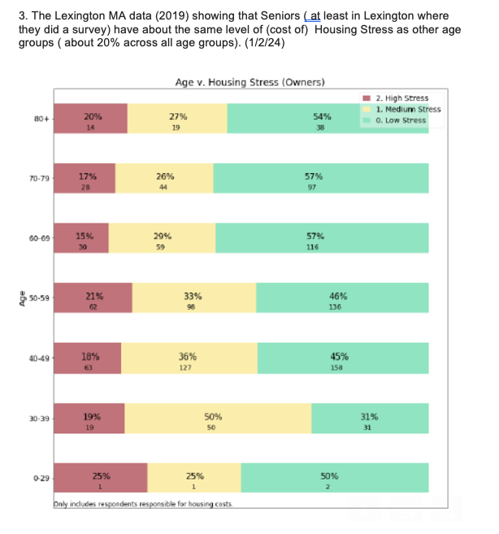
TFC Research
High Housing Financial Stress is about the same at 20% across all Age Groups

Slide 10
TFC Research Comparative Senior Financial Status
Seniors – as a group – are not more financially stressed regarding housing costs than other age groups.
Questions
How many in Lancaster would really benefit from an SME? How to gather data?
Conduct a Lancaster survey
Talk to Lexington
Obtain information from other towns
Notes:
References:
1. Lexington data
2. Federal and other data

Slide 11
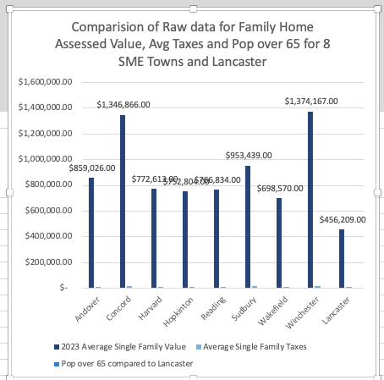
TFC Research What can we learn from 8 Towns that have implemented an SME?
Obtained and read their documents
Researched their SME Parameters
What can we learn from characteristics of those towns?

Slide 12
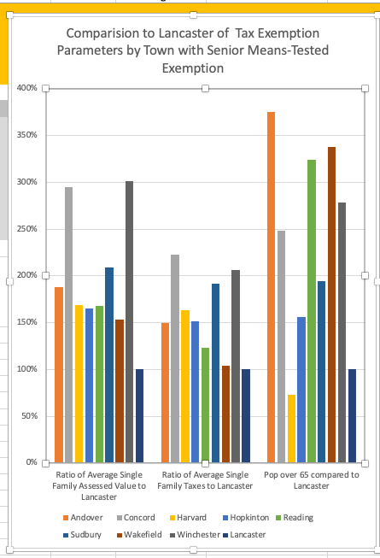
What can we learn from Normalizing (Lancaster as 100%) and Comparing selected Financial and Demographic Parameters of 8 Current towns with SME Programs with Lancaster
Observations about Financial and Demographic Information
Of the 8 towns with current SME Programs,
All 8 have an Average Home Assessed Value of more than 150% of Lancaster’s.
6 of 8 have Average Taxes more than 150% of Lancaster’s.
The two closest are Wakefield (104%) and Reading (122%)
7 of 8 have Senior Populations (over 65) more than 150% of Lancaster’s
Only Harvard’s is smaller
Tax Fairness Committee had formulated questions to understand this data and its implications.
- On Hold, pending the Governor’s recent Proposal

Slide 13
TFC Research Lancaster has different Financial/Demographic characteristics than 8 current SME towns
Comparison to Current SME Towns
Lancaster has
Lower home values
Lower taxes
Fewer Seniors
Investigate by
Questions to these towns
Lancaster Survey
Info from CB filing process ( if possible)

Slide 14
Proposal Promote the MA Circuit Breaker Tax Credit Maximum Eligibility - Owners and renters are eligible Max check $2590 for 2023 tax filing Retroactive for three years, up to ~$6,110 No cost to Lancaster, but significant and rapid benefit to Seniors Apply by April 14, 2024, for 2020, for maximum benefit Working with COA, LCC, HHS to promote
Notes:
can be extremely helpful to Seniors (max $2590 in FY 2024) but is a. Unknown/Not well known by Seniors b. Not understood c. Often blocked
High % of Seniors could qualify and benefit
1. Joint COA/HHS/TFC Edu./application preparation team
2. MOST IMPORTANT STEP WE CAN TAKE NOW ( GREATEST $ BENEFIT, BROADEST ELIGIBILITY, QUICKLY AVAILABLE, URGENCY ( BY 4/14 FOR 2020 $1150)
3. Request
3A. $15k Supplemental for 2024 to help file CB Appln
3B. $15k in FY25 to help Seniors file State/CB Applns

Slide 15
Proposal Promote the MA Circuit Breaker Tax Credit Why are we making this proposal now? 1. Immediately Implementable 2. Broadly applicable (Owners and Renters) 3. Provides real financial benefit now
Notes:
can be extremely helpful to Seniors (max $2590 in FY 2024) but is a. Unknown/Not well known by Seniors b. Not understood c. Often blocked
High % of Seniors could qualify and benefit
1. Joint COA/HHS/TFC Edu./application preparation team
2. MOST IMPORTANT STEP WE CAN TAKE NOW ( GREATEST $ BENEFIT, BROADEST ELIGIBILITY, QUICKLY AVAILABLE, URGENCY ( BY 4/14 FOR 2020 $1150)
3. Request
3A. $15k Supplemental for 2024 to help file CB Appln
3B. $15k in FY25 to help Seniors file State/CB Applns

Slide 16
Call to Action - for Seniors
Seniors
Have you filed your MA Income Tax Schedule CB for the last 3 years?
If yes, great!
If No or Not Sure
Then call your tax preparer soon (deadline to file by 4/14/24) and ask
Have you filed a MA Income Tax Schedule CB for me for the last 3 years?
If not, please do so asap to meet 4/14/24 deadline.
If don’t have a Tax Preparer, contact LCC, and they will make referral.
Filing CB Schedule could be worth (0 - $6110) for 4 years ( 2020 – 2023)
Ref. – Circuit Breaker Videos 2; 1. short, 2. more detailed https://www.youtube.com/watch?v=6CJOfKwyXj8
.

Slide 17
Call to Action – for Family/ Friends of Seniors/(Everyone)
Call/email Senior Family Member/Senior Friends and ask
Have you filed the MA Income Tax Schedule CB for the last 3 years?
If yes, great!
If No or Not Sure
Then call your tax preparer soon (deadline to file by 4/14/24) and ask
Have you filed the MA Income Tax Schedule CB for me for the last 3 years?
If not, please do so asap to meet 4/14/24 deadline.
Filing CB form could be worth (0 - $6110) for 4 years ( 2020 – 2023)
If they don’t have a Tax Preparer, contact LCC, and they will make referral,
Ask them to call/email others
Ref. – Circuit Breaker Videos 2; 1. short, 2. more detailed https://www.youtube.com/watch?v=6CJOfKwyXj8
.

Slide 18
Tax Fairness Committee Process
Good/Willing to Work Committee Members – Debra Sanders, Denise Hurley (10/23 – 1/24), Dick Trussell, Haidee LeClaire, Shelia Casey, Susan Munyon, Roy Rezac. | Broad Charter – do the right thing by the town in areas of SME and Tax Fairness | Learn from Other – 8 towns that have implemented an SME
Good process leads to good results | Do fact-based research/analysis of the problem/proposal to address. | Understand Lancaster’s problem before we implement a solution.
Our meeting process Consider other sides to issue and other points of view Respect others | Working groups - 7 members enables working groups of up to 3. Divide and conquer | Help we have received from others Kate Hodges, Kelly Dolan and Caitlin Roy, COA, Lancaster Town Employees ( Kathi Rocco, Mandy Cannon, Jill Hazelrigg, Bobbi Jo Williams, Marcia Sands, …) Others - Kendra Dickinson, Nikki Kanis

Slide 19
Next Steps for Tax Fairness Committee
Work with COA, HHS, LCC on CB program education, communication and Implementation
Tax Fairness – begin discussions – generally, in Lancaster
Tax deferral investigation
SME analysis on hold pending Governor’s proposal
Notes:
Do all we can to get volunteer/free aid for Seniors to file CB/State taxes

Slide 20
Summary
Based on the broad Mission given to TFC, we have
Prioritized SME analysis and near-term tax relief for Seniors
Researched
Senior Means-Tested Exemption(SME), Circuit Breaker (CB), and Tax Deferral (TD)
Proposed a near-term Circuit Breaker Program
Doing coordinated communication and education efforts with COA,HHS, LCC, TFC
The Circuit Breaker Education and Implementation program provides:
More money
To more Seniors
Faster
At No cost to Lancaster
Than any other approach we know.
“Call to Action” to involve all Lancastrians to “get the word out” to help Seniors.
Defined Next steps
( P.S. TFC needs one more member; please apply to Select Board. )

Slide 21
Backup Slides

Slide 22
Status of TFC regarding SME Proposal
Do not have enough data to Propose that, Yes, Lancaster should implement an SME Program
Questions raised on prior slides
Do Not have enough data to Propose that, No, Lancaster should not implement for next several years
Given above, what should we propose to help Seniors and Lancaster while more data is gathered/recommendation made?
( Governor’s announcement of 1/19/24 would have rendered a Yes or No recommendation moot/need to be reconsidered)

Slide 23
MA Income, Circuit Breaker (CB), Senior Means-Tested Exemption, and Tax Deferral Compared
Total Income - $50k
Relationship between MA Income, Circuit Breaker, Senior Means-Tested Exemption and Tax Deferral ( Seniors >65)
+ Add
+ Social Security
+ Retirement Income
+ Public Assistance
+ ..
+ Report
+ RE Taxes paid or Rent
+1/2 Water and sewer
+ Assessed Value
+ ….
2024 Taxes on
Avg Home
Tax -$8534
CB Max $2590
a
After CB - $5944
CB Max - $2590
SME - $944
10% of Tot. Income -$5k
MA AGI
Tax
Deferral
Low MA Income/No MA Tax/ File
Forms: MA Income Tax CB Appln TD Appln

Slide 24
Status of TFC regarding SME Proposal
Regarding an SME Proposal in Lancaster in the near term
Do not have enough data to Propose that, Yes, Lancaster should implement an SME Program
Questions raised on prior slides
Do Not have enough data to Propose that, No, Lancaster should not implement for next several years
Given above, what should we propose to help Seniors and Lancaster while more data is gathered/recommendation made?
( Governor’s announcement of 1/19/24 would have rendered a Yes or No recommendation moot/need to be reconsidered)

