Slide 1
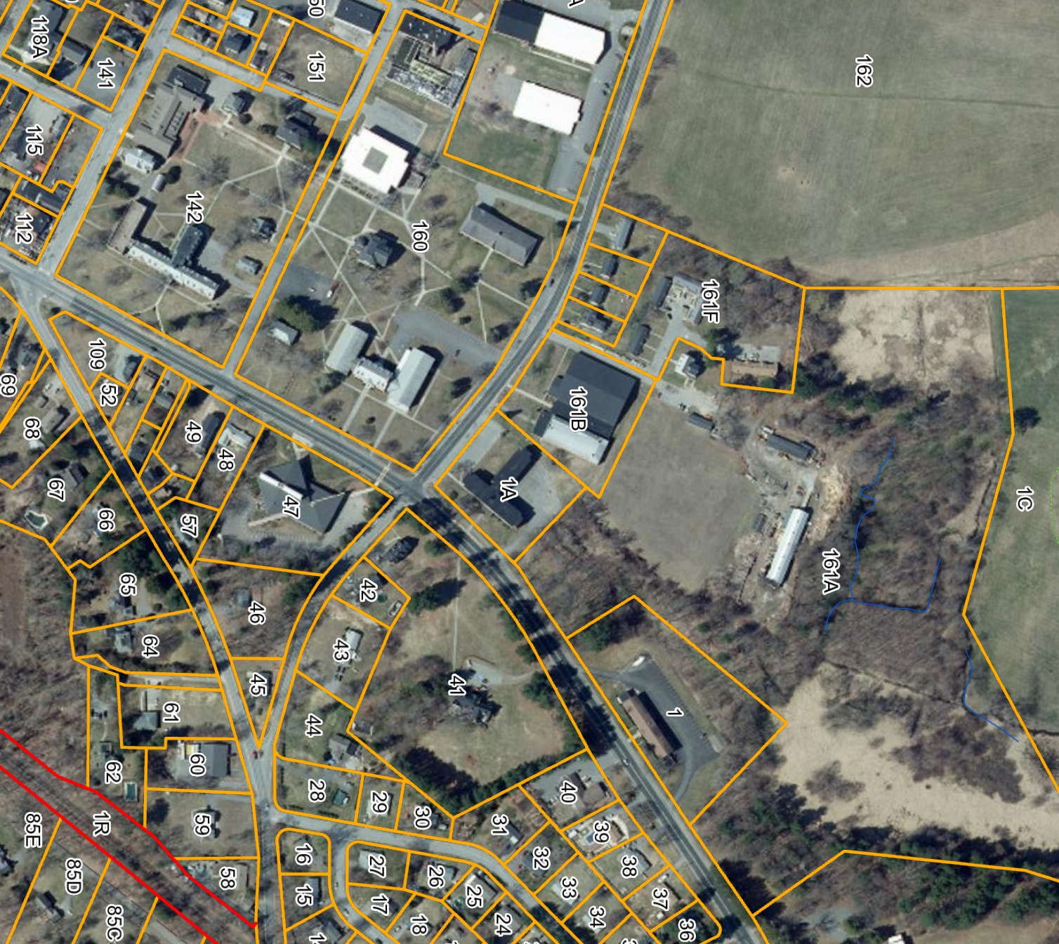
Atlantic Union College Campus
South Lancaster, MA
34 Acres
18 Individual Structures
College Campus closed in 2018
Zoned A3 Religious Use
Adequate Sewer Credits Remain
Existing Uses Can Continue
Accessory Uses Allowed
Buildings of Varying Age/Condition
Currently No HVAC or Power
Proposed Adventist Education Center
Power House
Dining Hall
Bindery
South Lancaster Academy
25 Orchard
Prescott House
35 Orchard
36 Flagg
Library
Science
26 Flagg
Founder’s Hall
Women;s Dorm
Museum
Admin
Field House
Kilbourne House
Men’s Dorm
College Church
Barn
AUC HQ
Seventh-day Adventist Church: AUC Campus Master Plan Study 6/7/23
Atlantic Union Conference

Slide 2
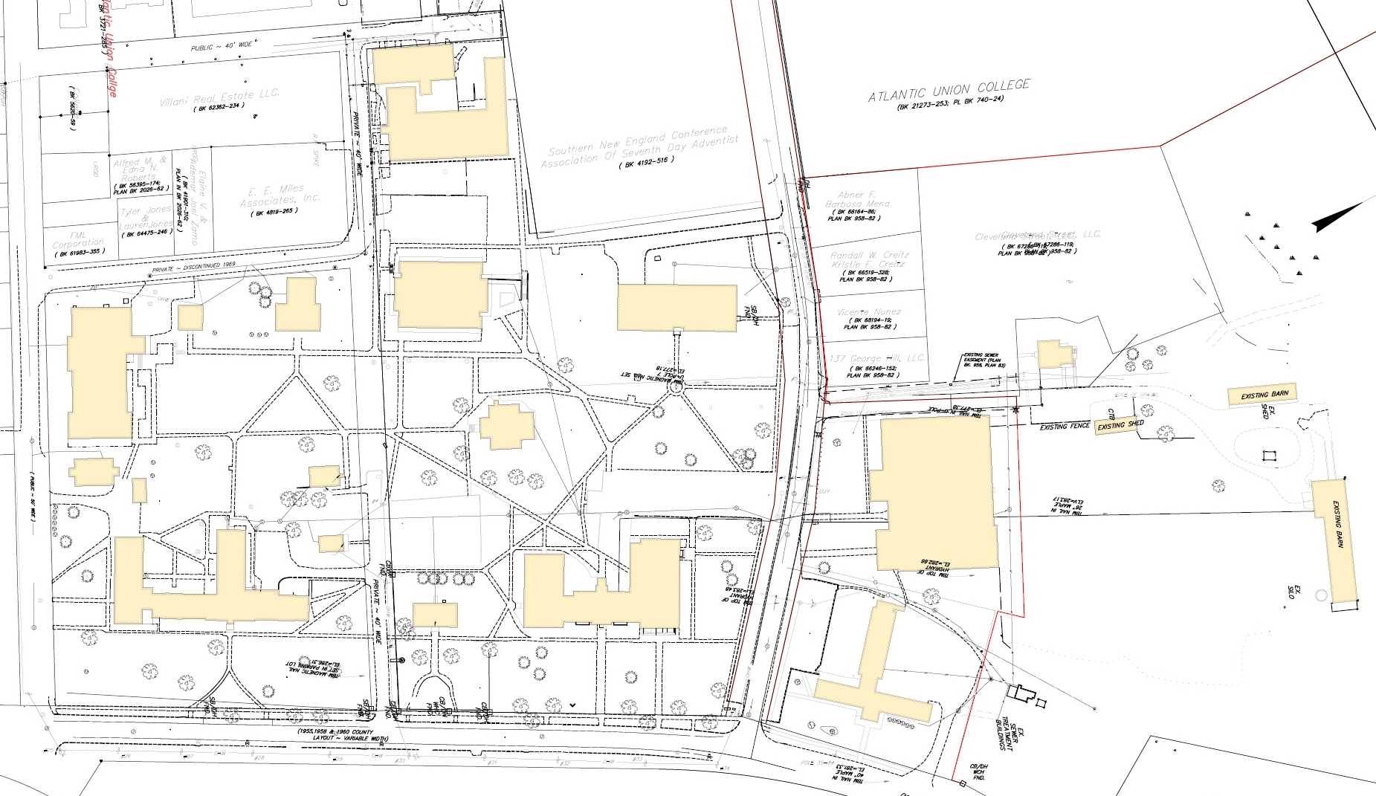
Existing Campus Plan
Maple Street
Power House
Flagg Street
Book Bindery
Parking
Orchard Street
Library
Science Building
25 Orchard
35 Orchard
Dining Hall
Kilbourne House
Founders Hall
Prescott House
36 Flagg
Parking
Athletic Center
Prescott Street
26 Flagg
George Hill Road
Barn
Women’s Dorm
Museum
Admin Building
Parking
Men’s Dorm
Main Street
Seventh-day Adventist Church: AUC Campus Master Plan Study 6/7/23
Atlantic Union Conference

Slide 3
Proposed Campus Plan
Maple Street
Power House
Community Services
Flagg Street
Parking
Orchard Street
School of Nursing and Vocational Arts
Classroom Building
25 Orchard
35 Orchard
Dining Hall
Kilbourne House
Founders Hall
Prescott House
36 Flagg
Parking
Fitness Center
Prescott Street
26 Flagg
SDA History Museum
Agricultural Program
George Hill Road
Senior and Student Housing
Atlantic Union HQ
Parking
Guest Residence
Main Street
Seventh-day Adventist Church: AUC Campus Master Plan Study 6/7/23
Atlantic Union Conference

Slide 4
School of Nursing
5- Classrooms for 50 students 6,000
Computer Lab for 75 students 1,200
Faculty and Staff Offices for 10 1,500
3- Simulation Labs with prep and storage 3,300
Reference Library 1,200
Copy Center 600
Conference Room 400
Compressors and gases room 250
15,450 sf
Vocational School
3 - Classrooms for 30 students 3,000
Computer Lab for 40 students 600
Faculty and Staff Offices for 6 1,000
3- Simulation Labs with prep and storage 3,600
Copy Center 600
Conference Room 300
Compressors and gases room 250
9,350 sf
Bathrooms, mechanical, lobbies/corridors/stairs, janitor 10,000 sf
Total Approximate SF 34,800 sf
Phase 1 Program
Seventh-day Adventist Church: AUC Campus Master Plan Study 6/7/23
Atlantic Union Conference

Slide 5
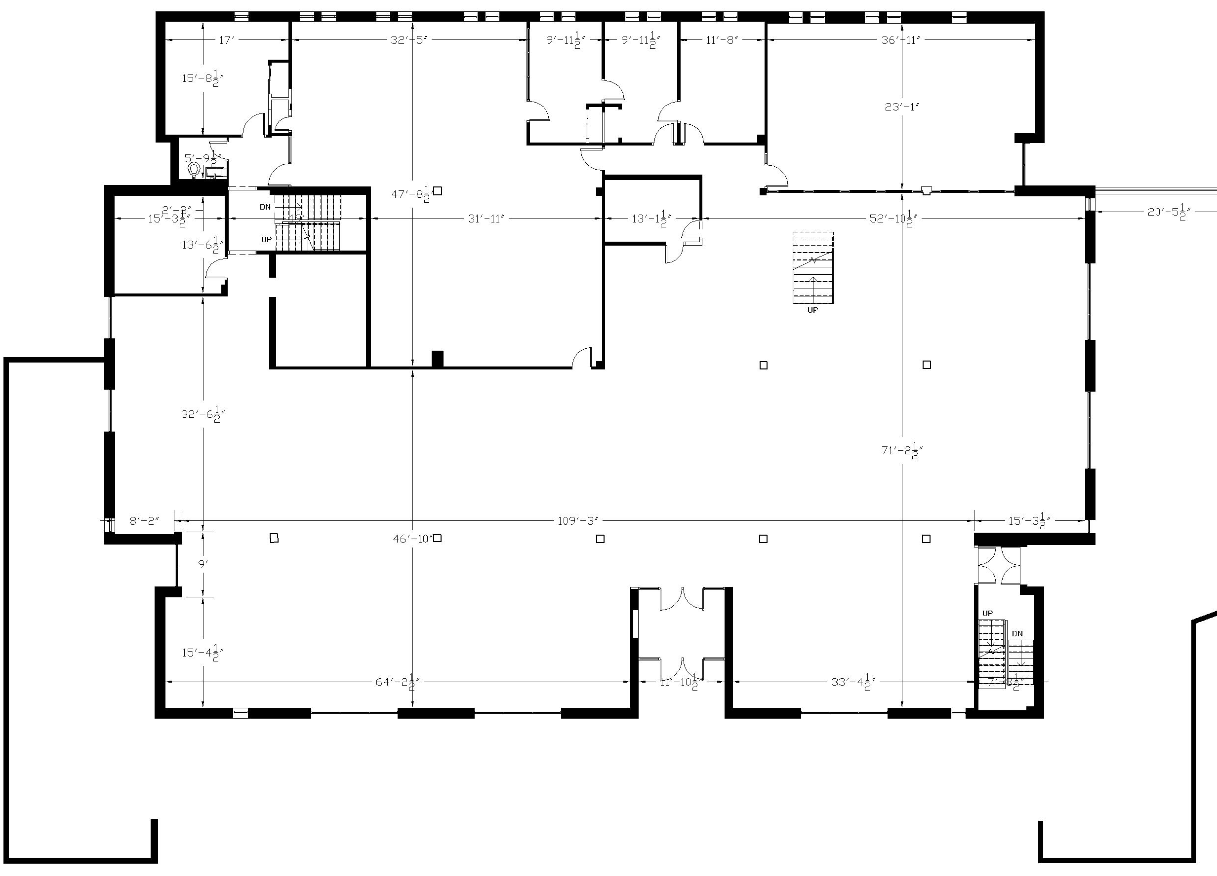
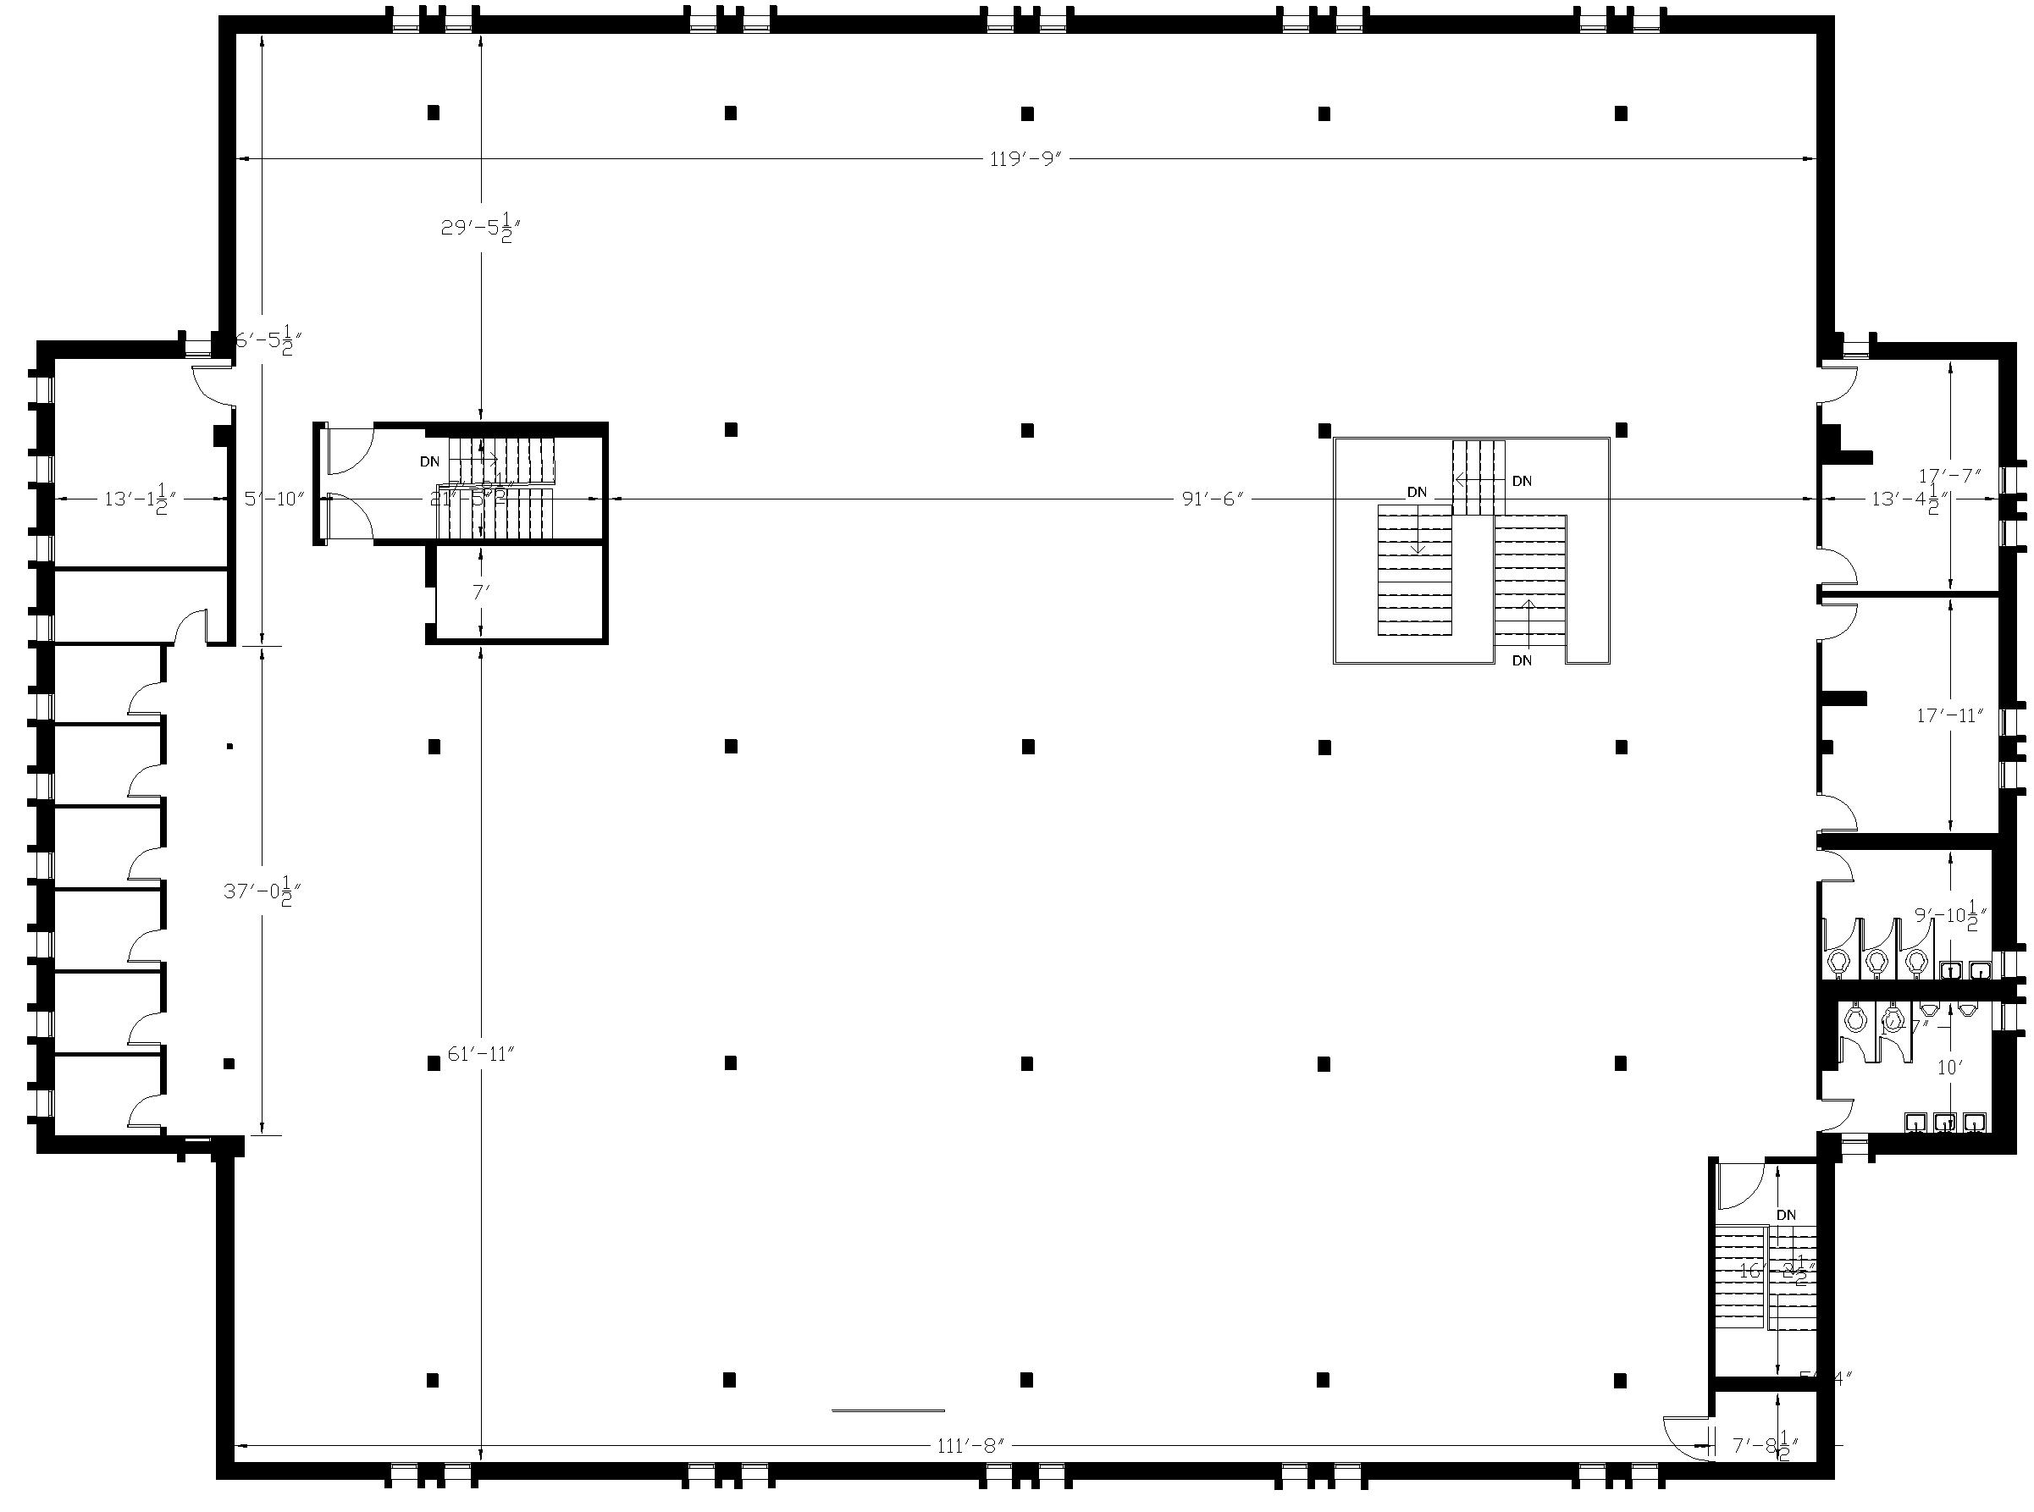
Basement Floor Plan
First Floor Plan
Library Building
40,260 SF Steel Framed Building with Brick Exterior Type 2A
Two story and full basement
Accessible entry and elevator, bathrooms not accessible
No sprinkler, FA, power or heat
Conforming for height/area for Use Group A3 and B
Leaking membrane roof, single glazed windows
Condition: Good
Second Floor Plan
Seventh-day Adventist Church: AUC Campus Master Plan Study 6/7/23
Atlantic Union Conference

Slide 6
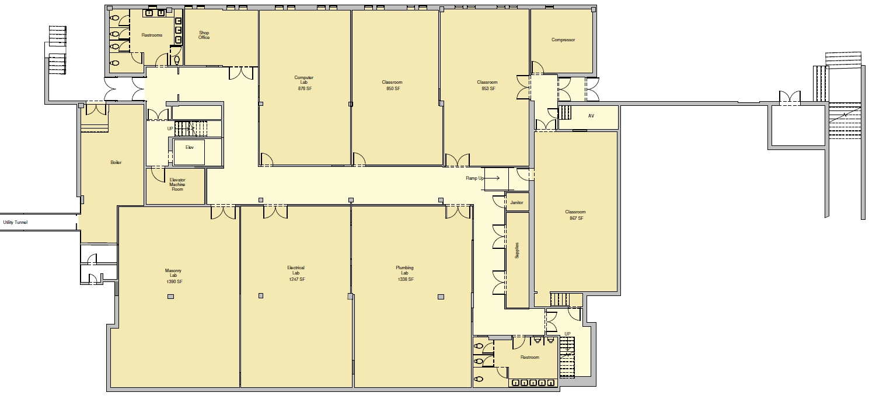
Library: Phase 1 Renovations
Basement – Vocational Arts Program
Seventh-day Adventist Church: AUC Campus Master Plan Study 6/7/23
Atlantic Union Conference

Slide 7
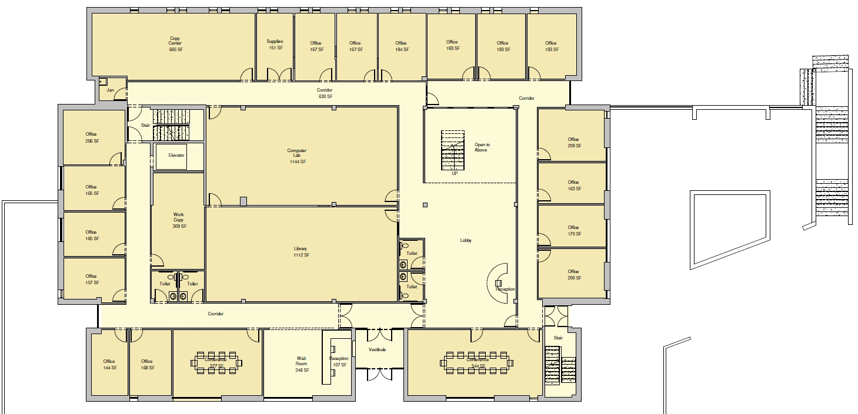
Library: Phase 1 Renovations
First Floor – Vocational Arts & Nursing Program
Seventh-day Adventist Church: AUC Campus Master Plan Study 6/7/23
Atlantic Union Conference

Slide 8
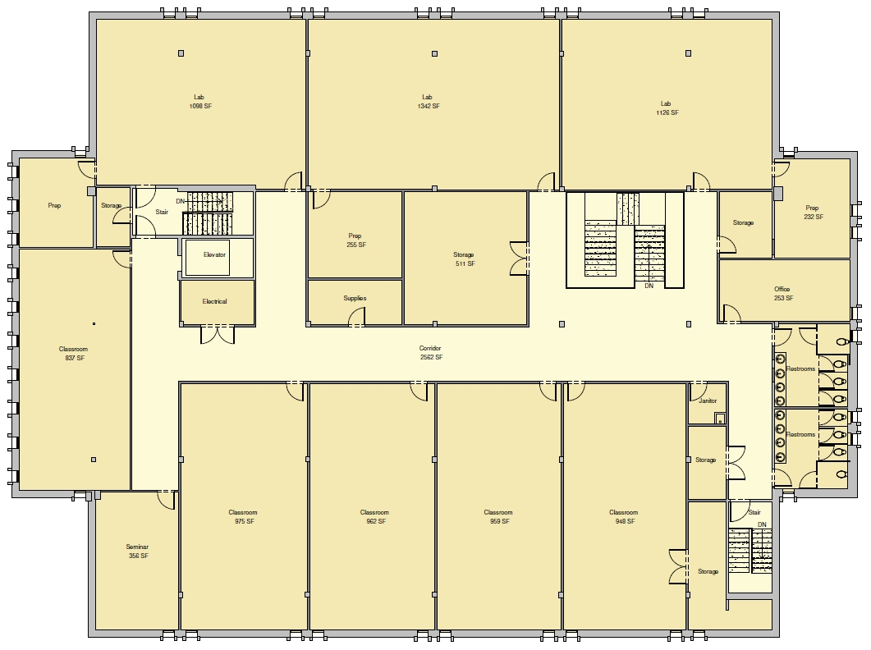
Library: Phase 1 Renovations
Second Floor– Nursing Program
Seventh-day Adventist Church: AUC Campus Master Plan Study 6/7/23
Atlantic Union Conference

Slide 9
Basement Plan
Dining Hall
18,335 SF Steel frame Building Type 2B
Single story with partial basement
Fully accessible
No sprinkler, power or heat
Kitchen equipment has been removed
Adequate egress
Condition: Good
First Floor Plan
Seventh-day Adventist Church: AUC Campus Master Plan Study 6/7/23
Atlantic Union Conference

Slide 10
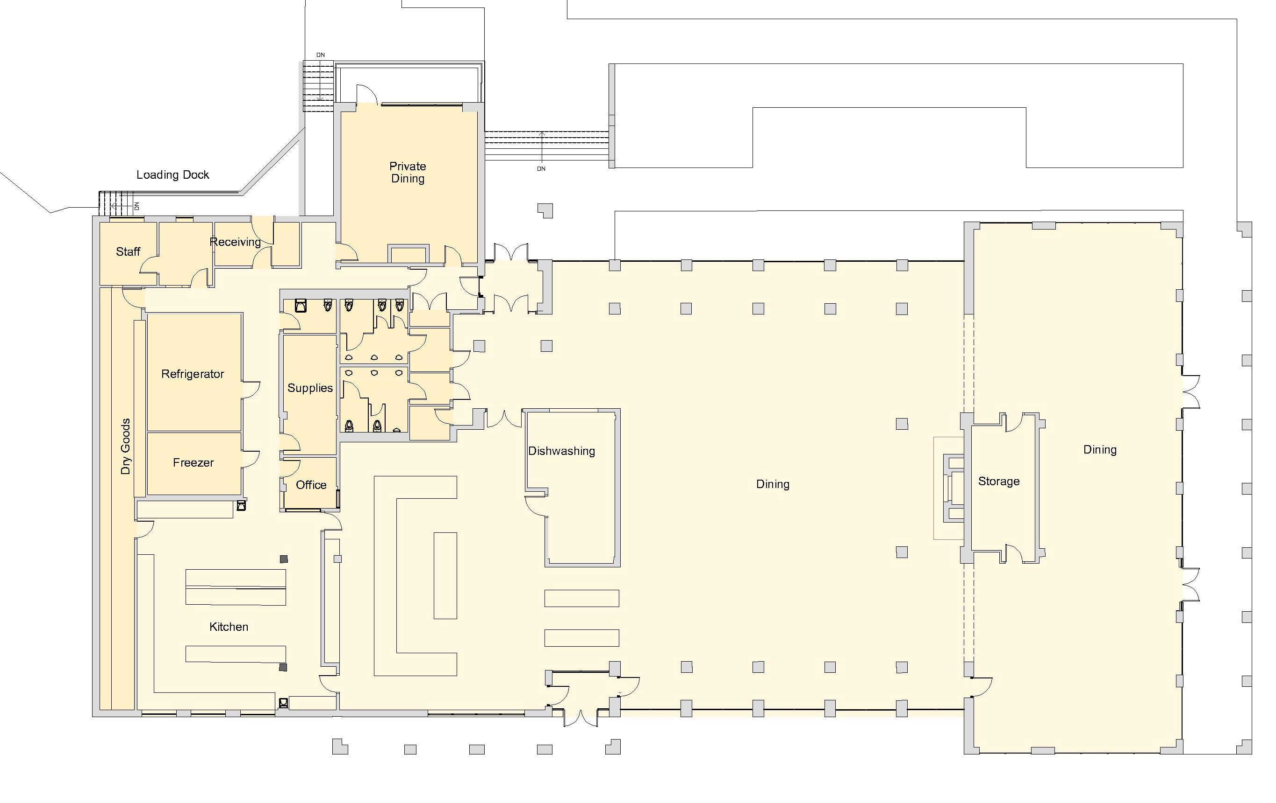
Dining Hall: Phase 1 Renovations
First Floor Plan
Seventh-day Adventist Church: AUC Campus Master Plan Study 6/7/23
Atlantic Union Conference

